Slide 1

SmartIrrigation Mobile App
[7/7/2017]
Project Release Plan
The Other Sense
Heather Eagle (Product Owner)
Christopher Henson (Scrum Master)
Sherif Elsaid
Sean Won
Kenneth Y Jiang
Daniel Friberg
Sponsored by SlugSense

Slide 2
SlugSense
Project Release Plan – Description
Problem: It is estimated that over half of irrigation water is going to waste. This is money down the drain.
Solution: SlugSense gathers and displays data that allows the user to irrigate efficiently. This reduces environmental impacts and cost.

Slide 3
High Level Goals
Project Release Plan
Welcome/Login Screen
Main page that displays data in graph
Sliding Menu
Pulling actual data from database
Login credentials

Slide 4
Sprint 1
Project Release Plan – User Stories
As a user, I want to see a welcome screen so that I can log in to my personal account.
As a developer, I want a website plan so that I have consistency in UI design.
Note: Sprint 1 has less user stories because the team was formed in the middle of sprint 1.

Slide 5
Sprint 2
Project Release Plan – User Stories
As a user, I want a main page with most of the relevant information, so that I have immediate access upon logging in.
As a user, I want a sliding menu with additional links, so that I can navigate through the app.
As a developer, I want real data access, so that I can test my interface in practical applications.

Slide 6
Sprint 3
Project Release Plan – User Stories
As a user, I want to view the information from my sensors in a clear way, so I can change my irrigation habits.
As a user, I want to be able to login to my account, so that I only see information relevant to myself

Slide 7
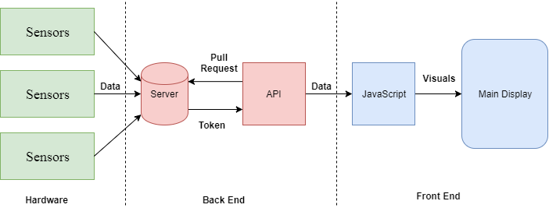
SmartIrrigation – Architecture

Slide 8
SmartIrrigation – Challenges/Risks
Unfamiliar technologies
Implementing User Credentials
Members from different sections
Difficulty coordinating with busy schedules
Notes:
Most group members do not have experience with mobile development

Slide 9
Technologies to be used
Project Release Plan – Technologies
Node.js(Express)
Ionic
Cordova
Angular
Languages: HTML, CSS, JS
Communication: Discord, Slack

